Slide 1
Title: TRAINING AND PLACEMENT OFFICE SOFTWARE
Team Members: Sudheer Kumar Seera(19NU1A05A1)
Ch. Bhargav(19NU1A0519)
P. Chandra Kiran(19NU1A0588) Gayathri Suresh(19NU1A0527)
Vyjayanthi Jenna(19NU1A0537)
Department: CSE

Slide 2
PROJECT AIM
To develop a mobile cum web application to track student count based on eligibility criteria
To upload/update student data based on latest exam results
To send custom mails to the companies inviting them to conduct drives
To send custom mails to eligible students notifying about the drive
To maintain a separate database to store the shortlisted candidates data specific to the company
To check if the placed candidate can appear for further drives according to company criteria

Slide 3
CURRENT PROBLEM
Placement cell members spend months planning and organizing a campus placement drive. Manual coordination of these tasks are cumbersome
Communicating with companies, sharing candidate information, to allocating slots requires a central planning
The lack of a centralized platform to manage data makes it difficult for them to communicate with companies and provide all the required information
Sharing candidate detail from exam cell to department to placement office is a long way

Slide 4
THE PROPOSED SYSTEM
The proposed software is a web application developed to resolve the current issues faced by the Training and Placement Office members
Our software system consists of an attractively designed frontend for user interactivity through which the user can pass the required query to obtain the required solution as per their filters applied
The backend of this software fetches the data sets in the form of csv files and then store it in a database
The required data is extracted as per the filter applied by the user and is computed and displayed on the UI
In the proposed software system, there is a feature to send custom mails to target destination

Slide 5
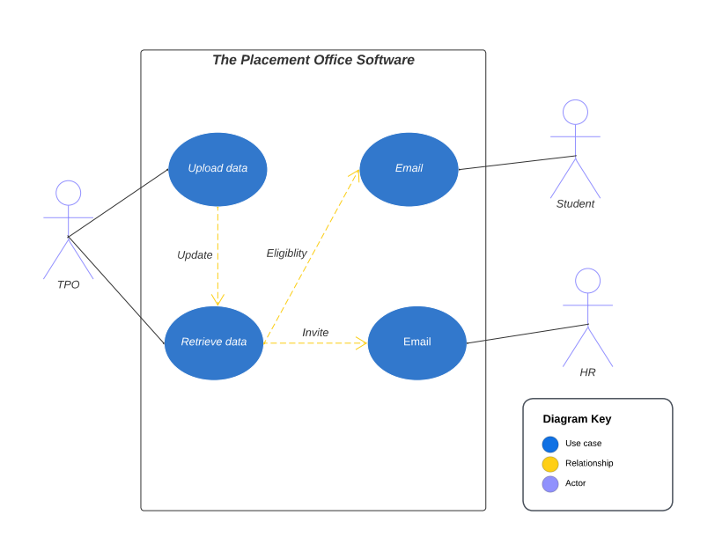
USE CASE

Slide 6
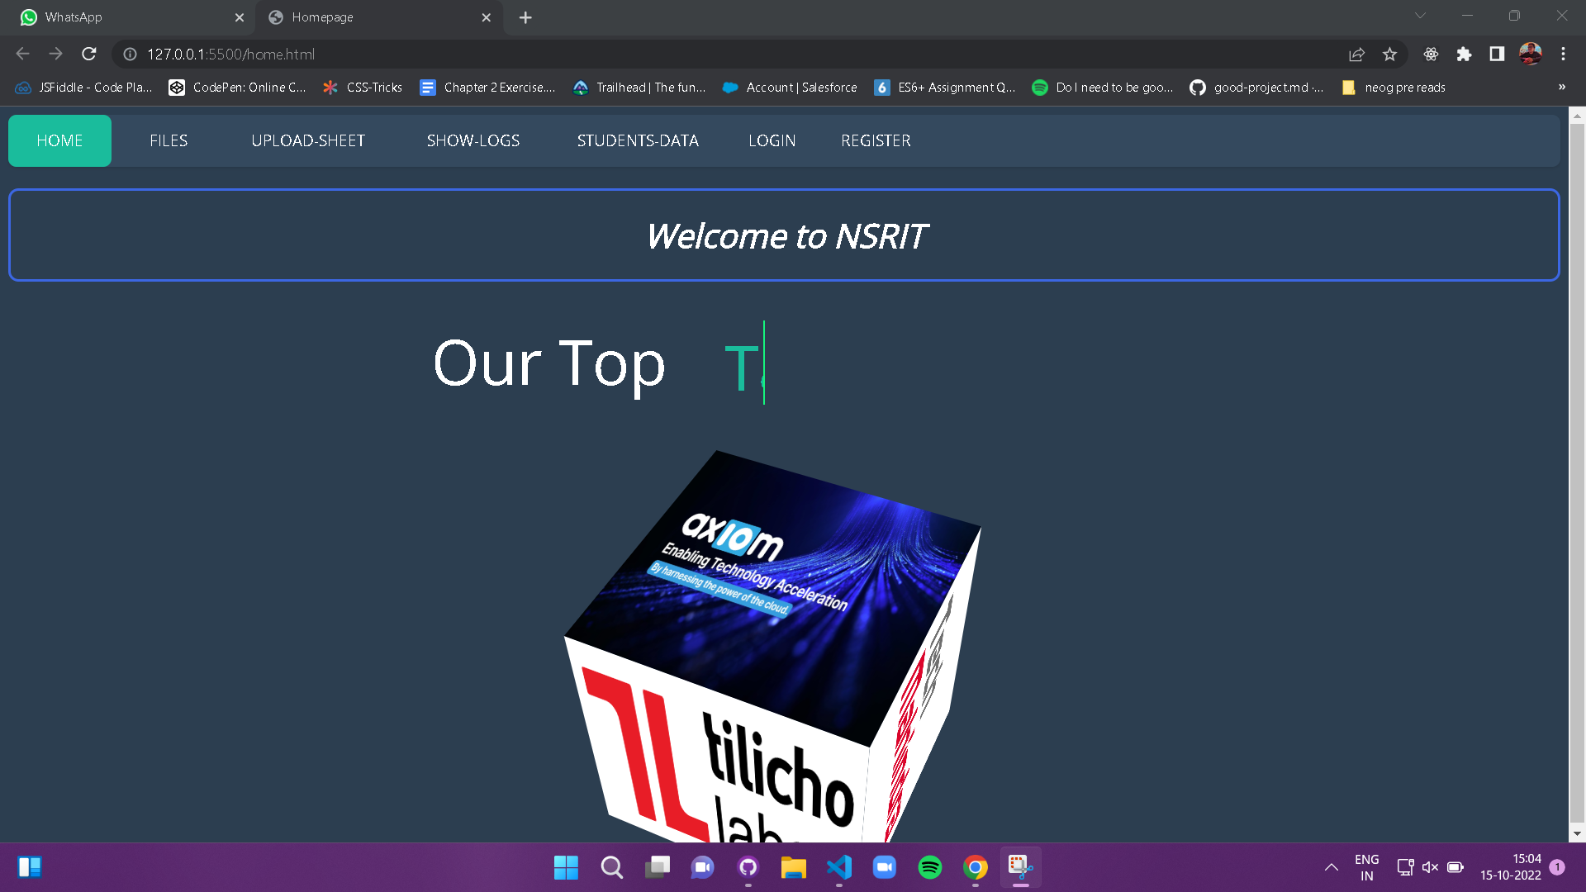
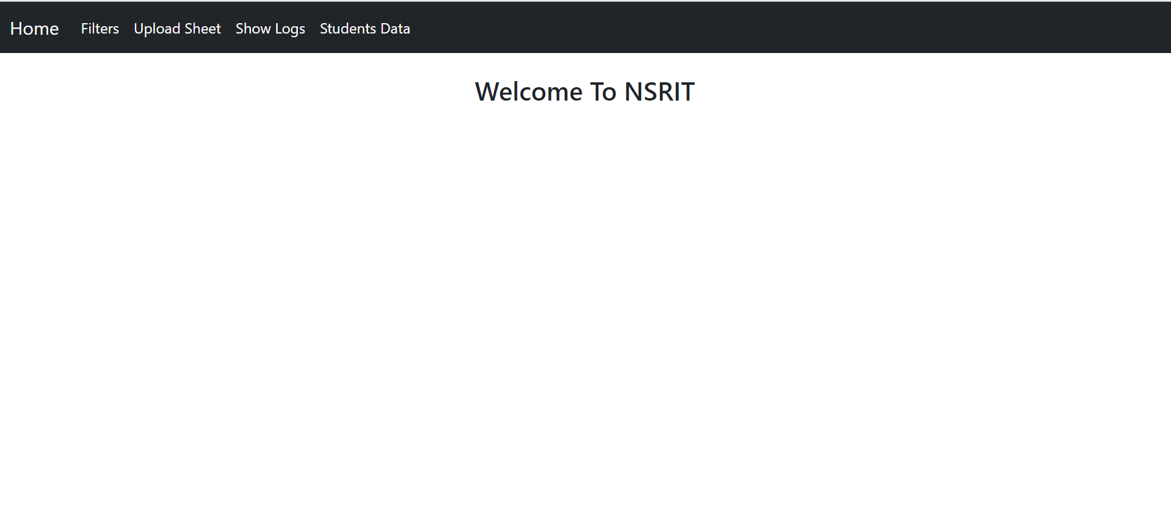
HOME PAGE

Slide 7
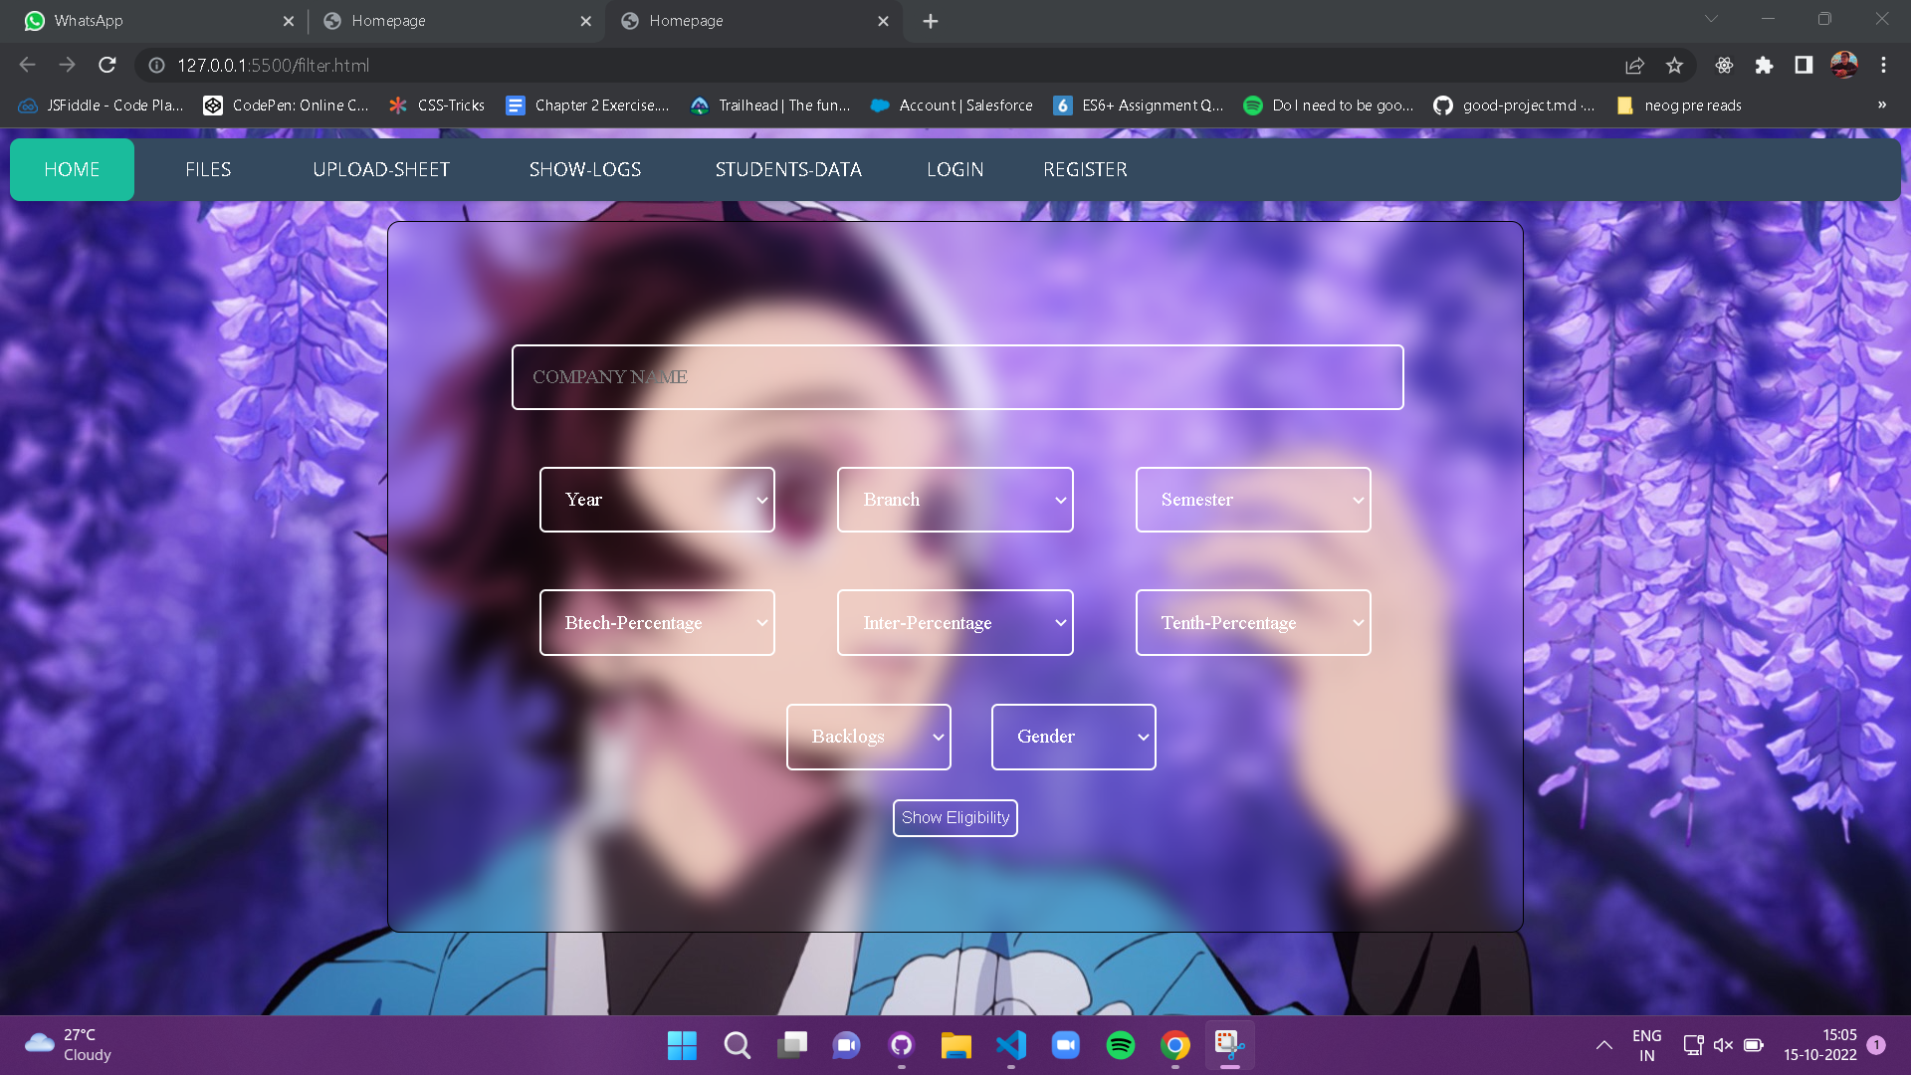
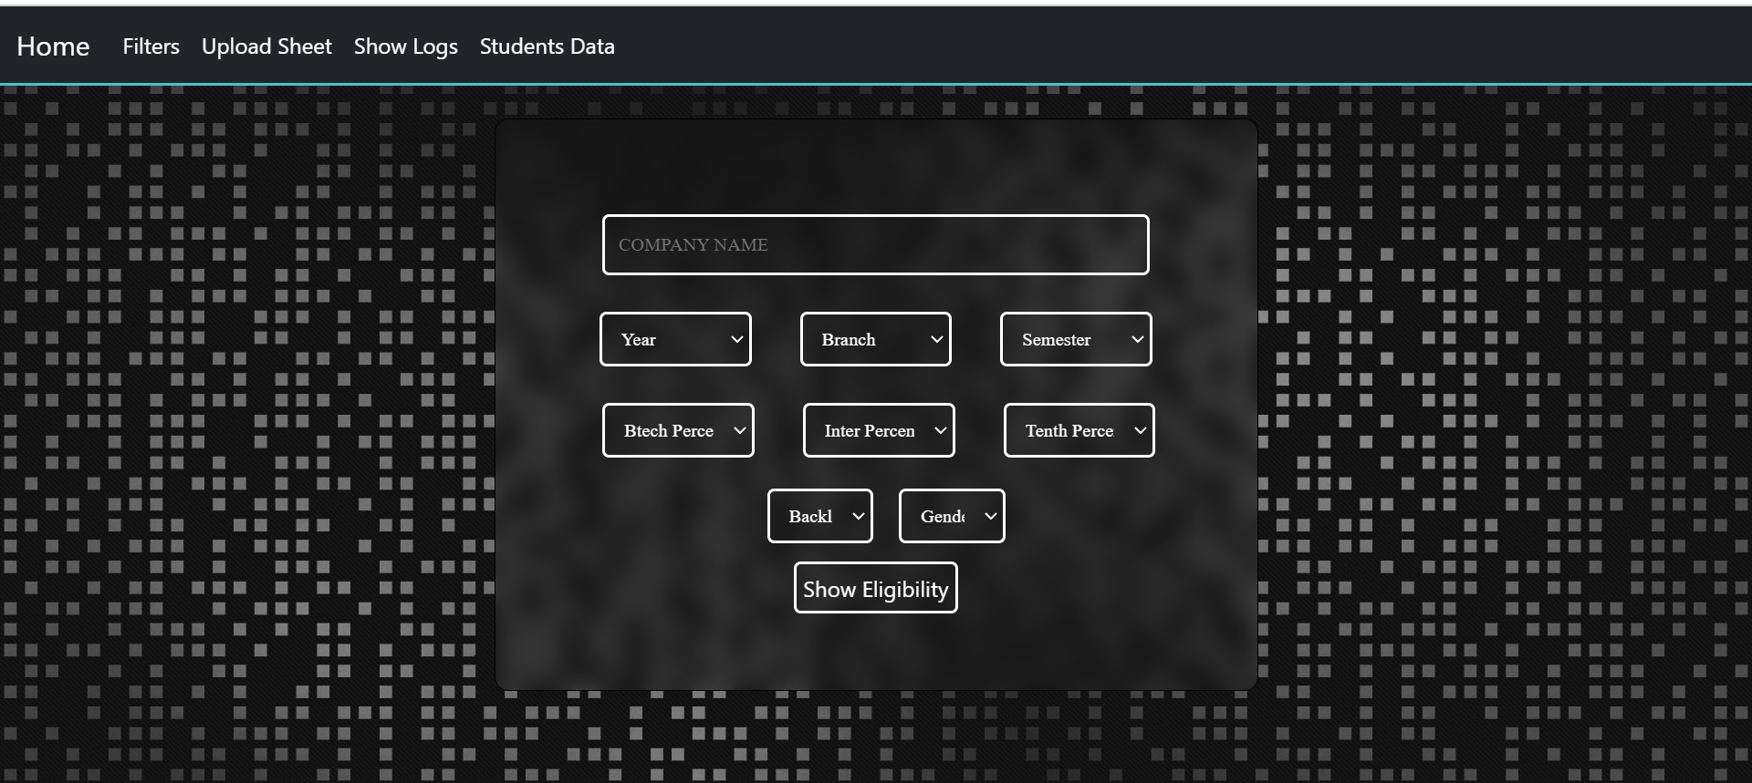
FILTERS PAGE
This Page is for submitting the eligibility filters based on which the eligible students have to be displayed.

Slide 8
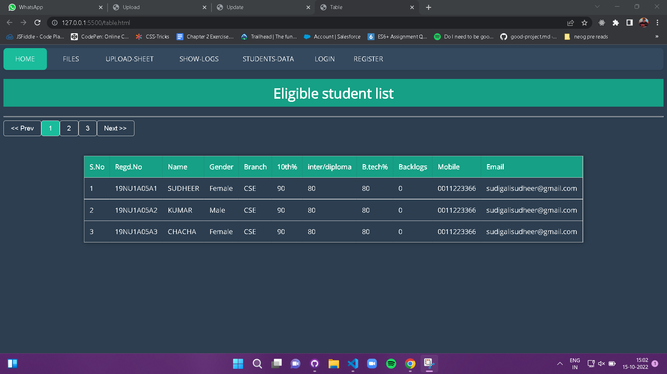
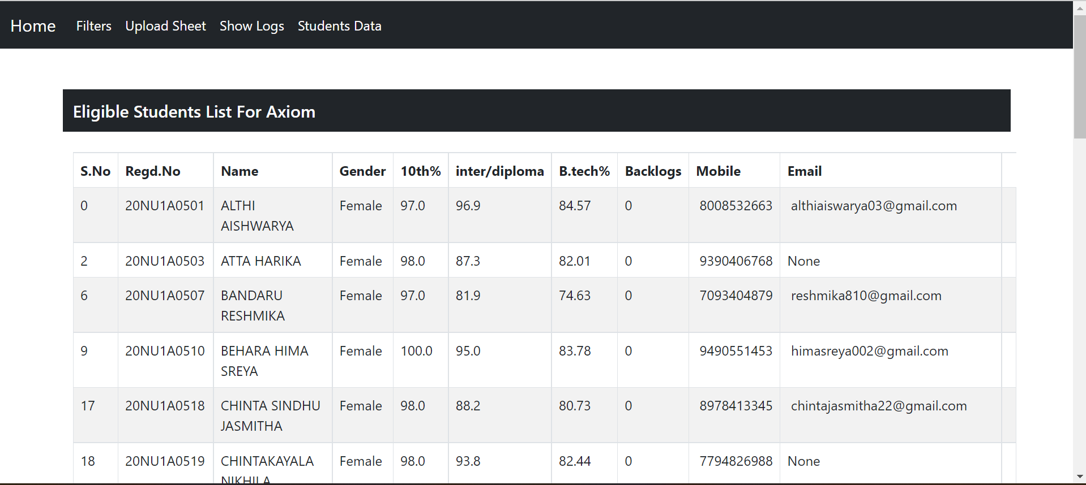
ELIGIBILITY LIST PAGE
This Page shows us the list of eligible students that are being filtered based on the filters submitted.

Slide 9
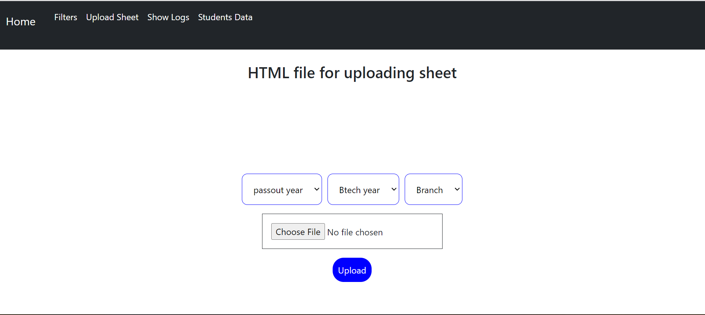
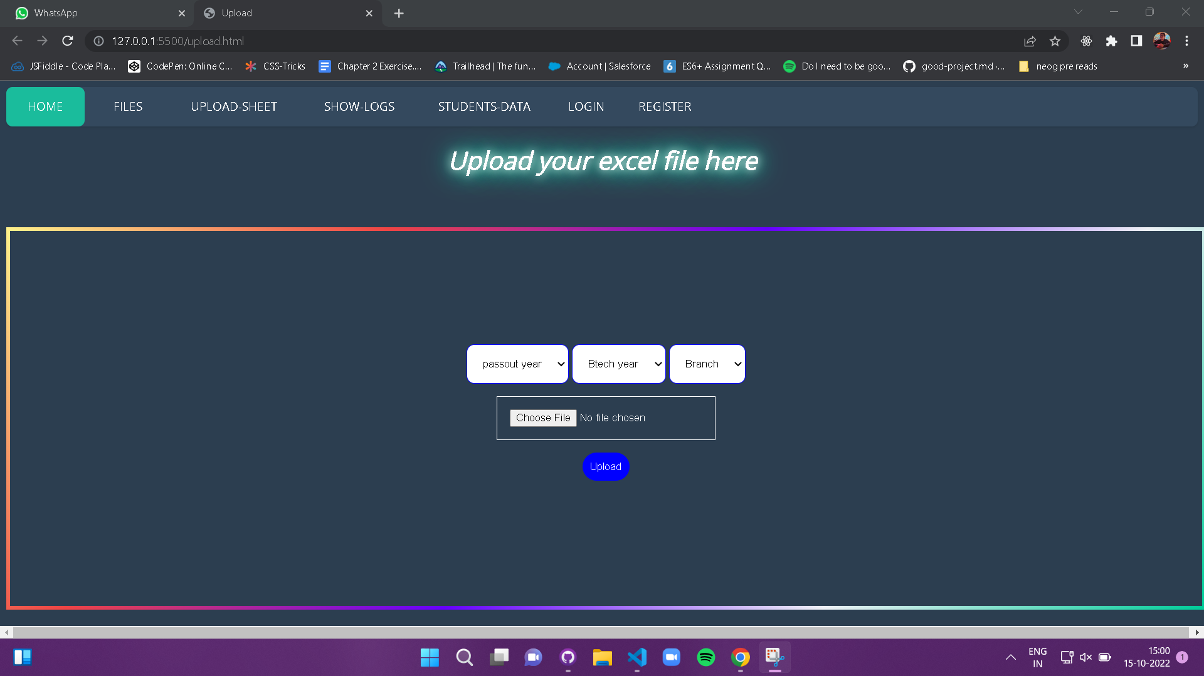
FILE UPLOAD PAGE
This Page is for uploading the updated files where we need to update the details of the students with their current backlogs and Percentages.

Slide 10
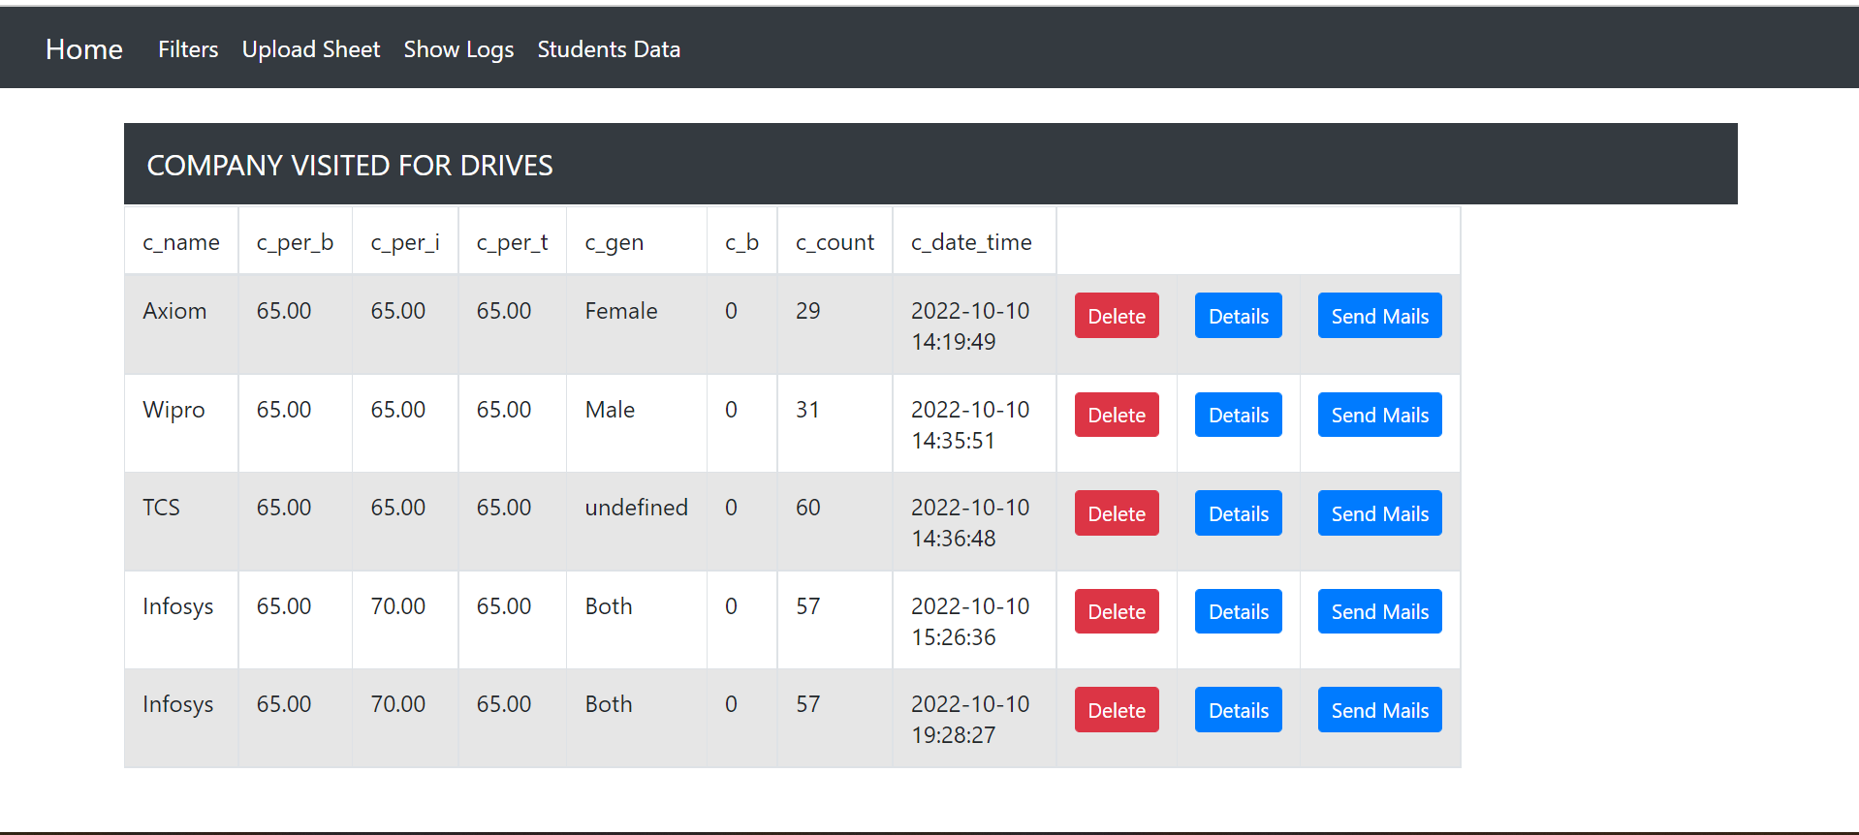
PLACEMENT DRIVE LOG PAGE

Slide 11
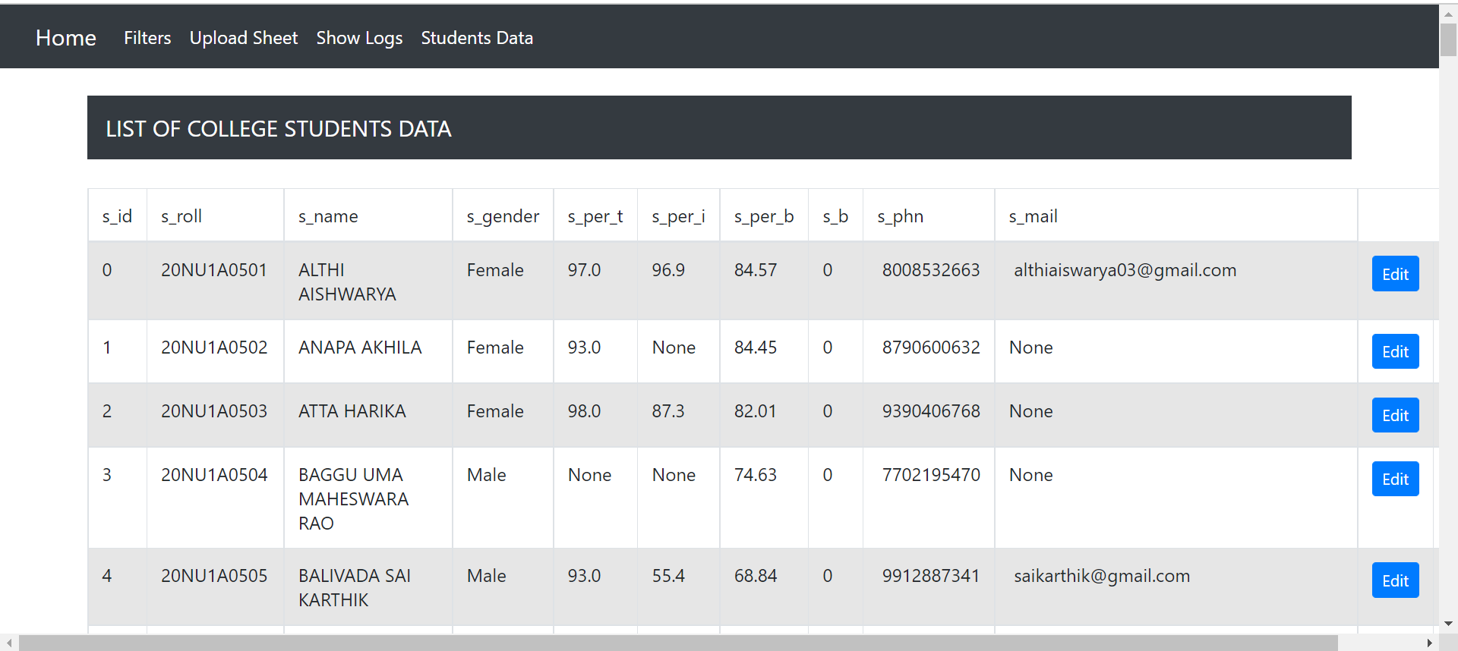
STUDENT DATA PAGE

Slide 12
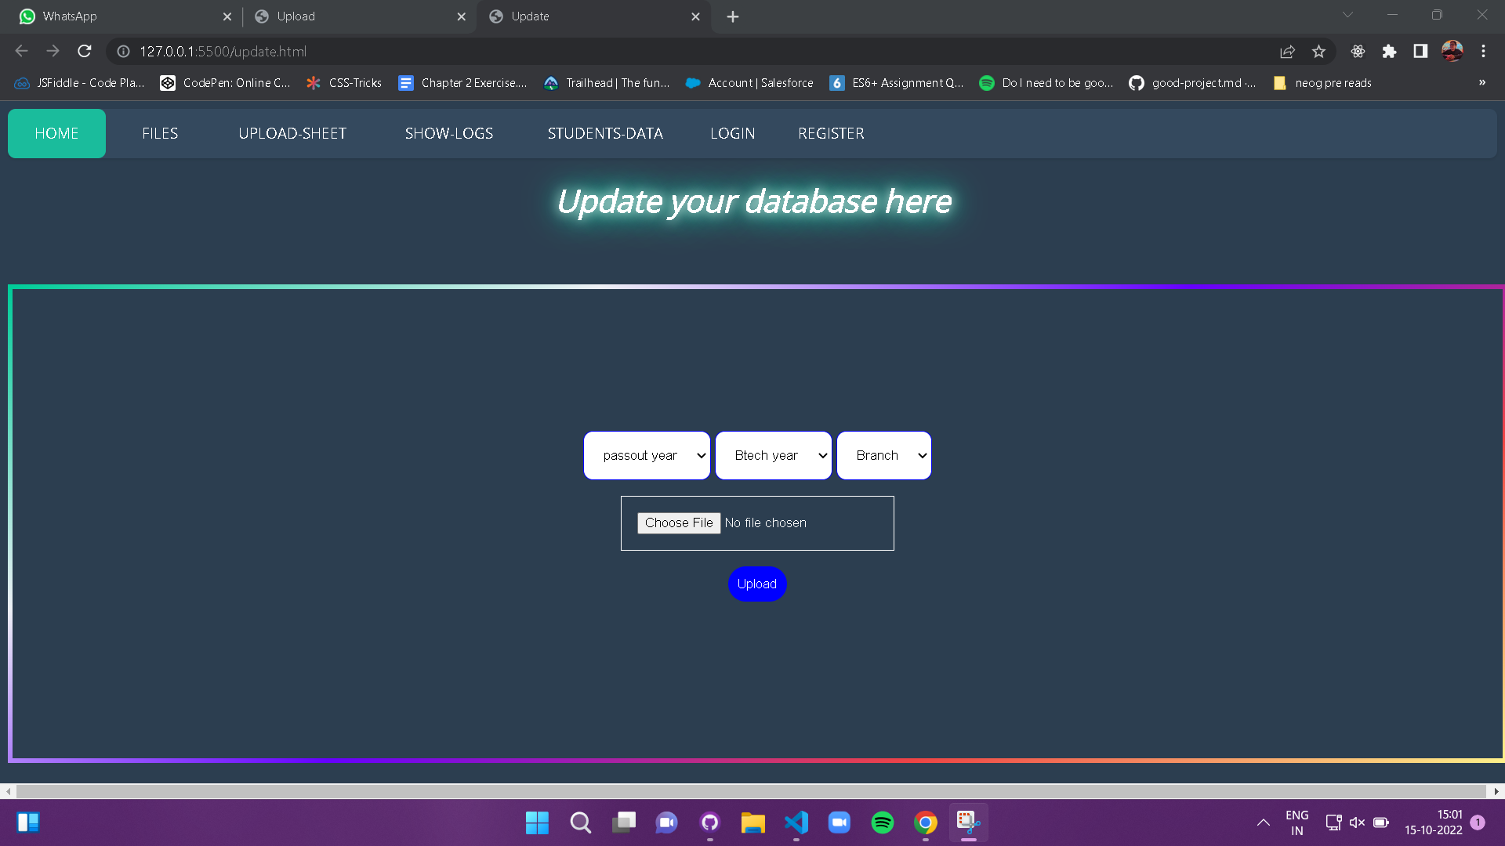
STUDENT DATA UPDATE PAGE

Slide 13
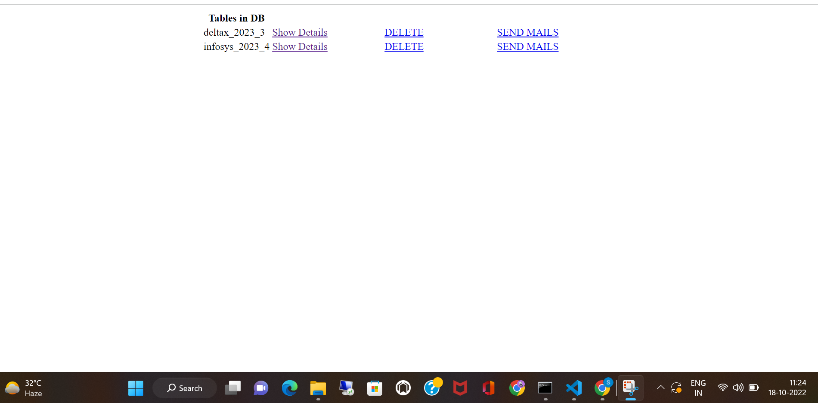
LIST OF COMPANIES VISITED PAGE
This Page displays the list of companies visited for the drives along with the student details separately.

Slide 14
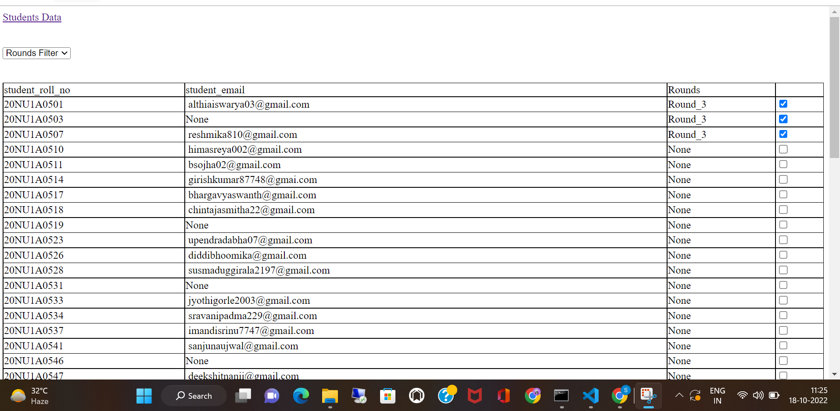
LIST OF COMPANIES VISITED PAGE
This Page displays the list of companies visited for the drives along with the student details separately.

Slide 15
MERITS OF THE PROPOSED SYSTEM
Interactive UI
Single-point data fetching
Automated computation
Multi-user access
Custom notification for eligible students

Slide 16
SOFTWARE REQUIREMENTS
Frontend - HTML, CSS, JavaScript
Backend - Python3
Framework - Flask
Libraries - pandas, openpyxl
Database - MySQL, SQLAlchemy
Operating Systems - Windows 7 or 10/Mac OS X 10.11 or higher,64-bit/
Linux: RHEL 6/7, 64-bit

Slide 17
HARDWARE REQUIREMENTS
CPU Architecture - Dual-core Intel Core i5 or similar/Graphics card/x86 64-bit CPU (Intel / AMD architecture)
RAM and free disk space - 4 GB RAM/5 GB free disk space

Slide 18
SOFTWARE DEVELOPMENT MODEL
Extreme Programming (XP)
Spiral

Slide 19
Thank You

